Slide 1

GAME 101 Presentation #2

Slide 2
Team Storm
Brett Blackstock - Project Leader, Lead Programmer
Michael Krause - Project Manager, Lead Narrative
Charlie Brown - Narrative / Utility
Wade Hetland - Narrative / Utility
Rachel Groth - Programmer
David Enersen - Lead Artist
Quincton Rush - 2D Artist
Skyler Wittmer - 2D Artist
Garrett Verhoeven - Contract Sound Designer

Slide 3
What is this game again?
Fighting Game!
Two characters (Randolf and Lynne) with four different enhancements, each with unique styles of play.
Enhancements include Death, Space, Life, and Time.
Players choose a character to determine moveset and an elemental enhancement to determine playstyle
Simple control scheme allows even beginners to compete.

Slide 4
Audio
Sound effect drafts for:
Normal attack hits
Special attack hits
Blocking
Movement
Basic Fight Song Draft

Slide 5
Programming
Playable game!
Dummy animations
Controller input
Flip hitboxes after side changes
Blocking zones and variable damage
Most attacks are implemented
Character and Element select implemented

Slide 6
Narrative
Created names for every special move
UI Stuff (Themed after our world)
Paper Prototype
Story Mode Outline
Symbols

Slide 7
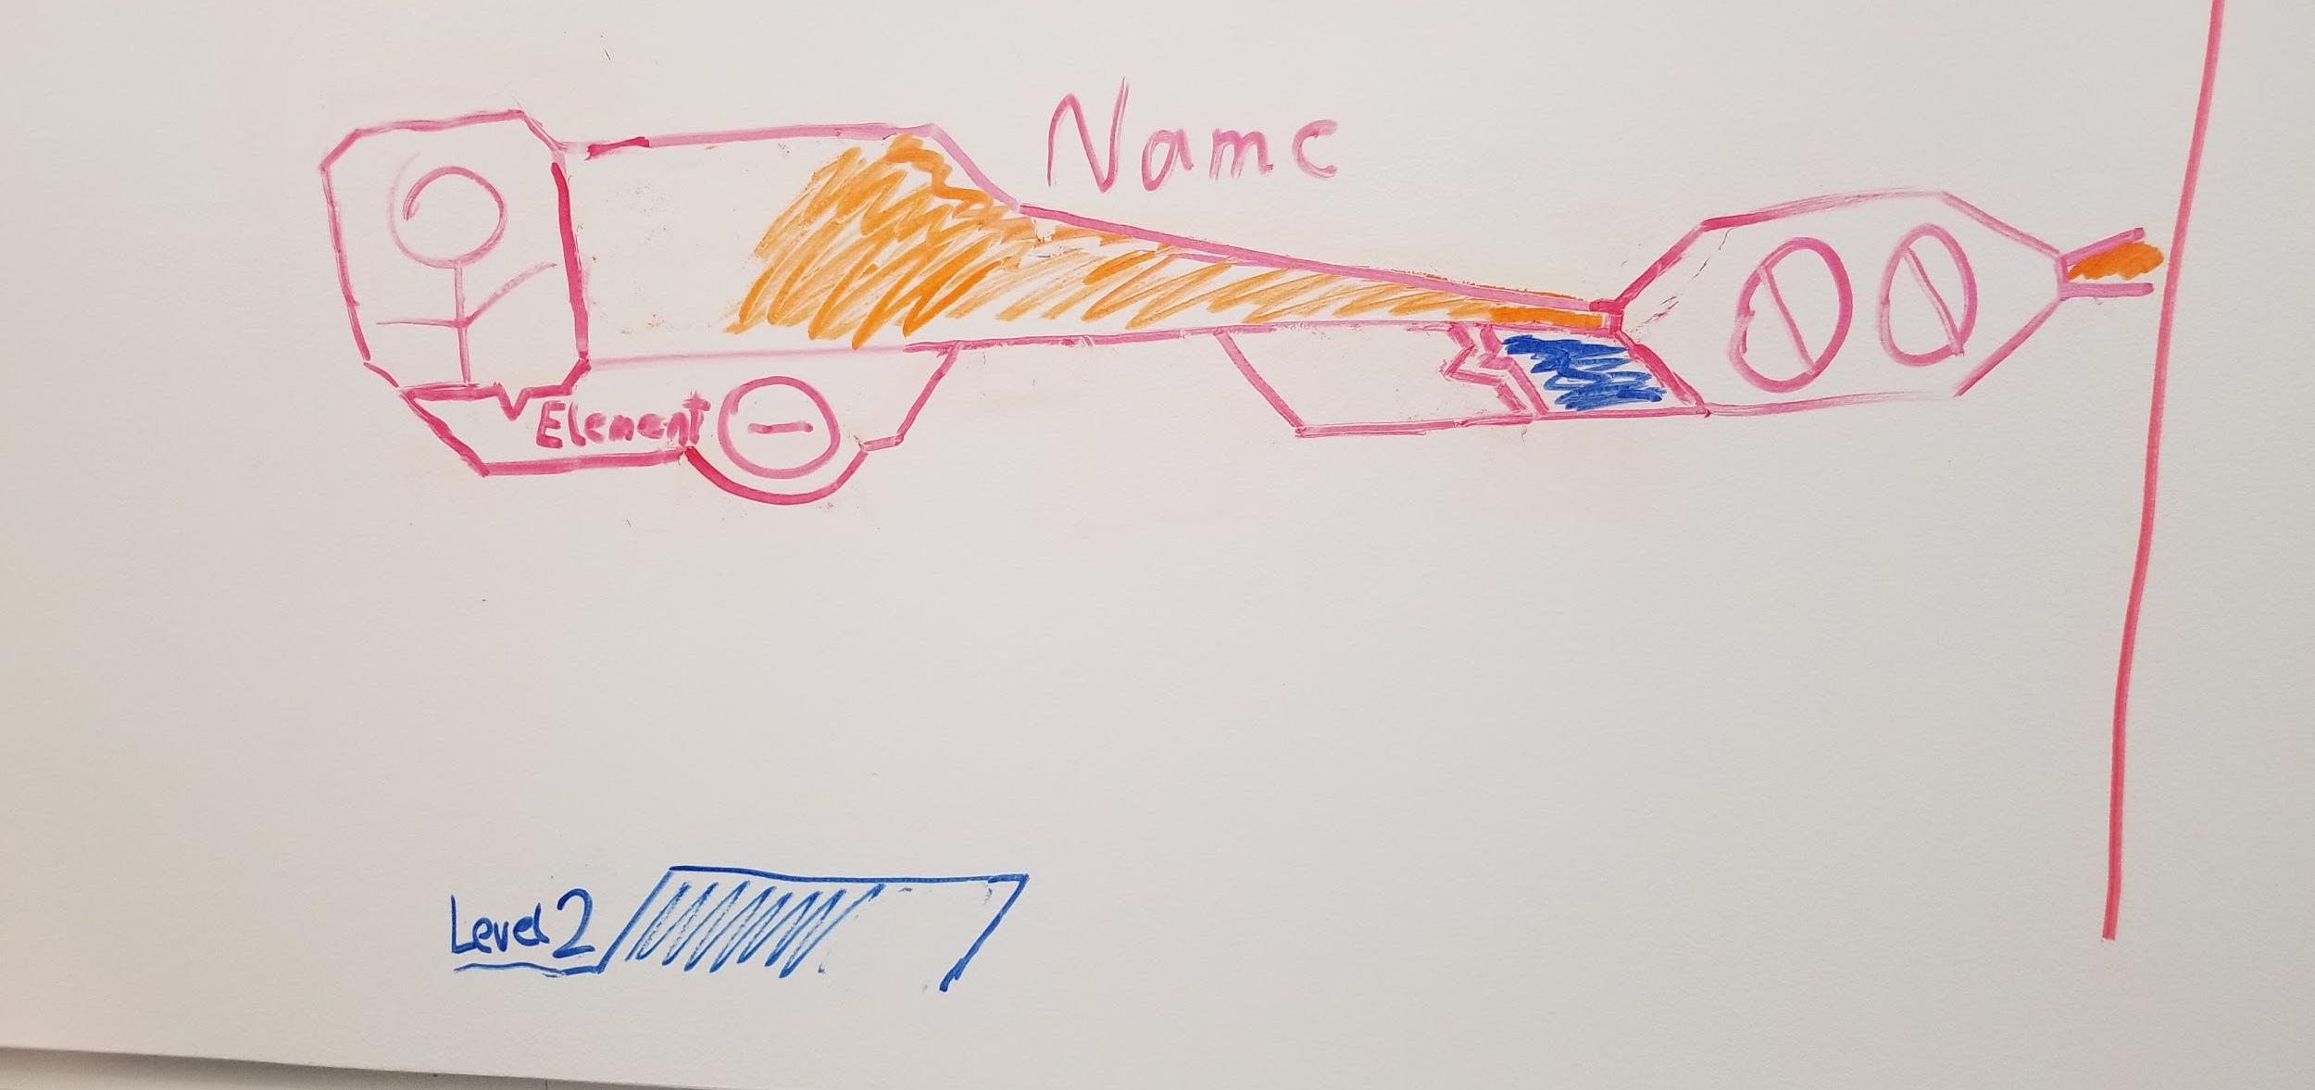
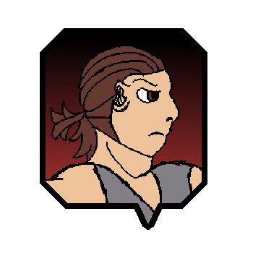
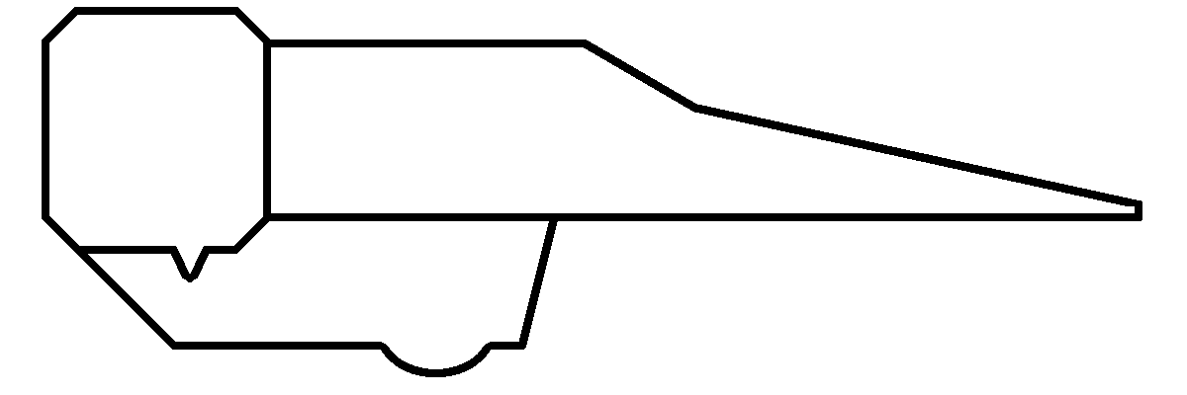





UI
UI theme decided upon
Angular, based off our theme
Battle UI drafted

Slide 8
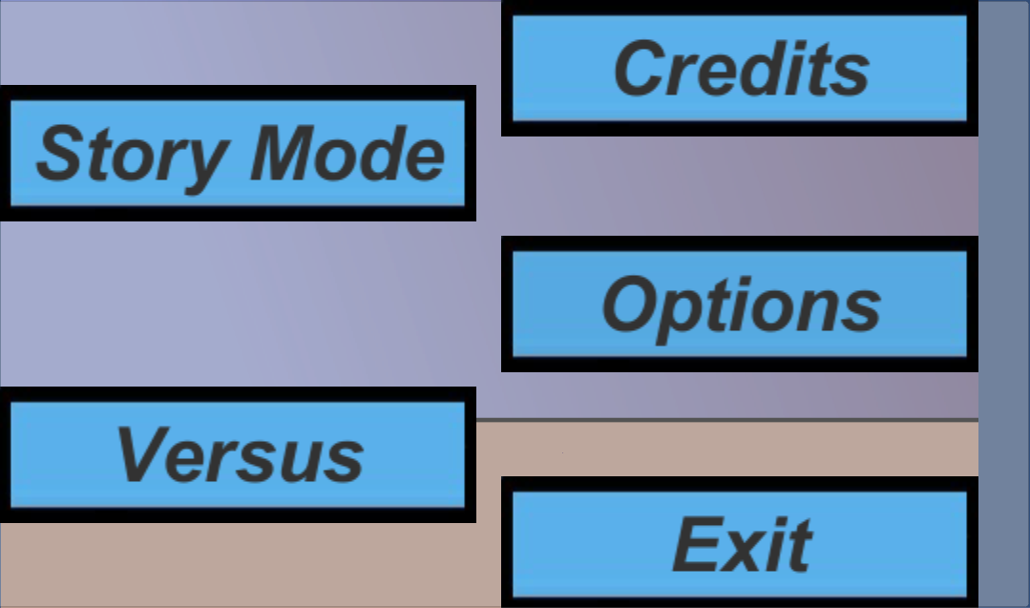
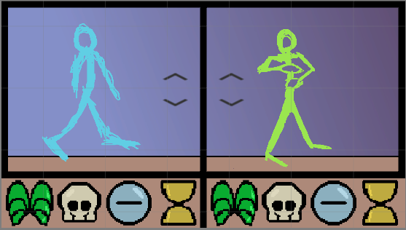
Menus
Prototype Main Menu and Character Select screens
Character and Element choices carry over
Menu advances once both players choose a character and element

Slide 9
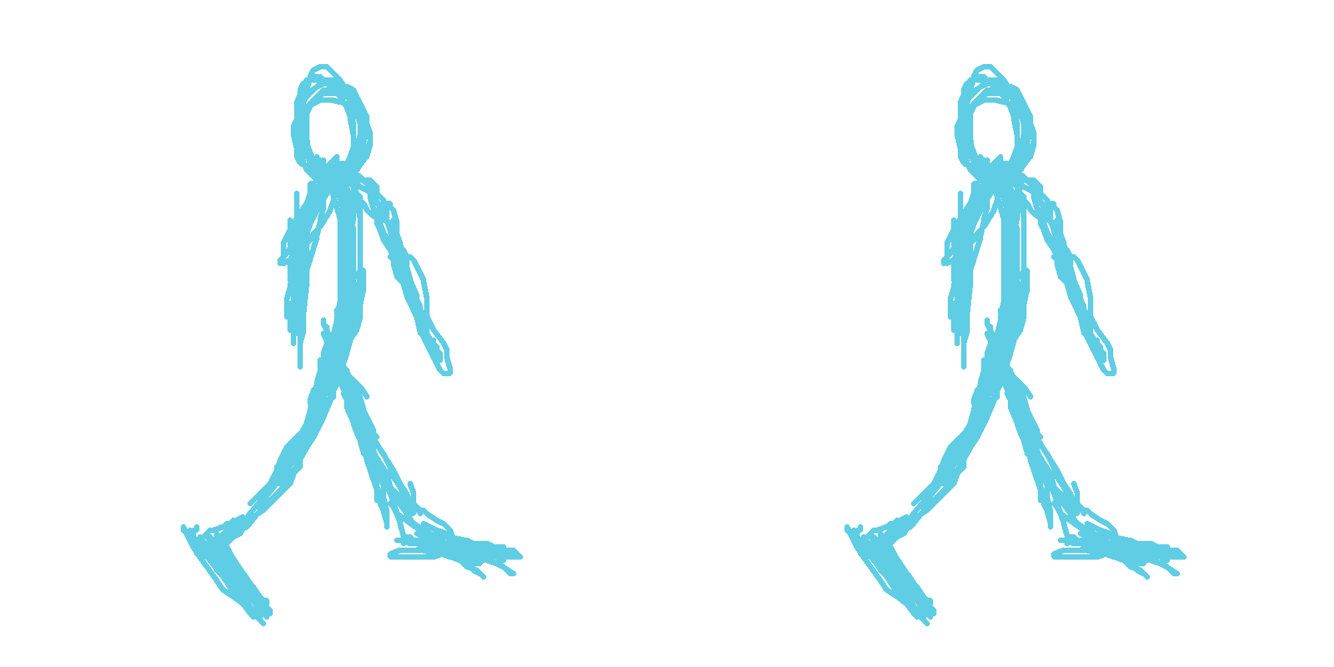
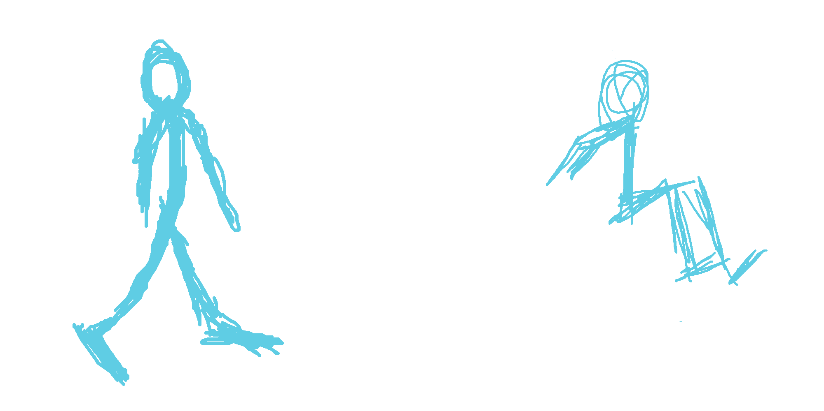
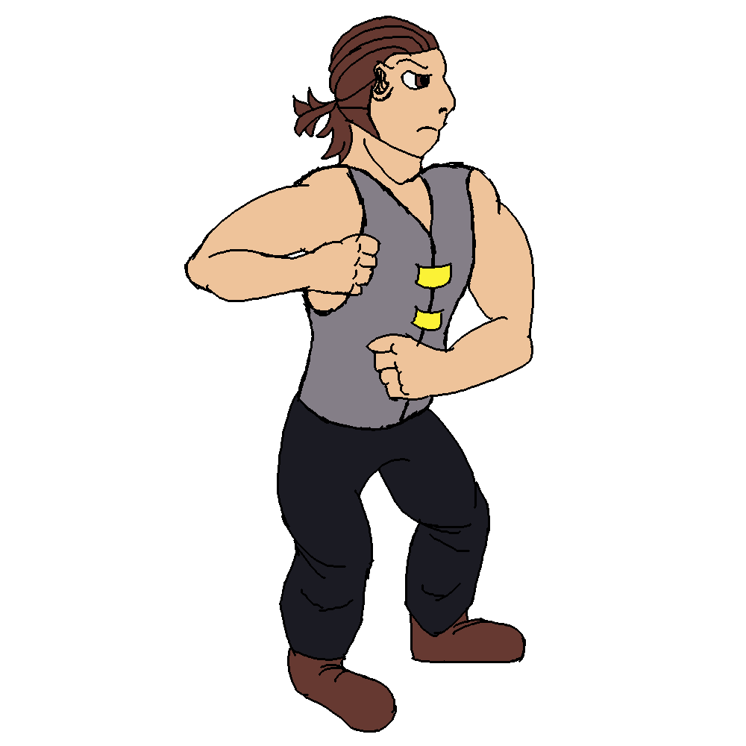
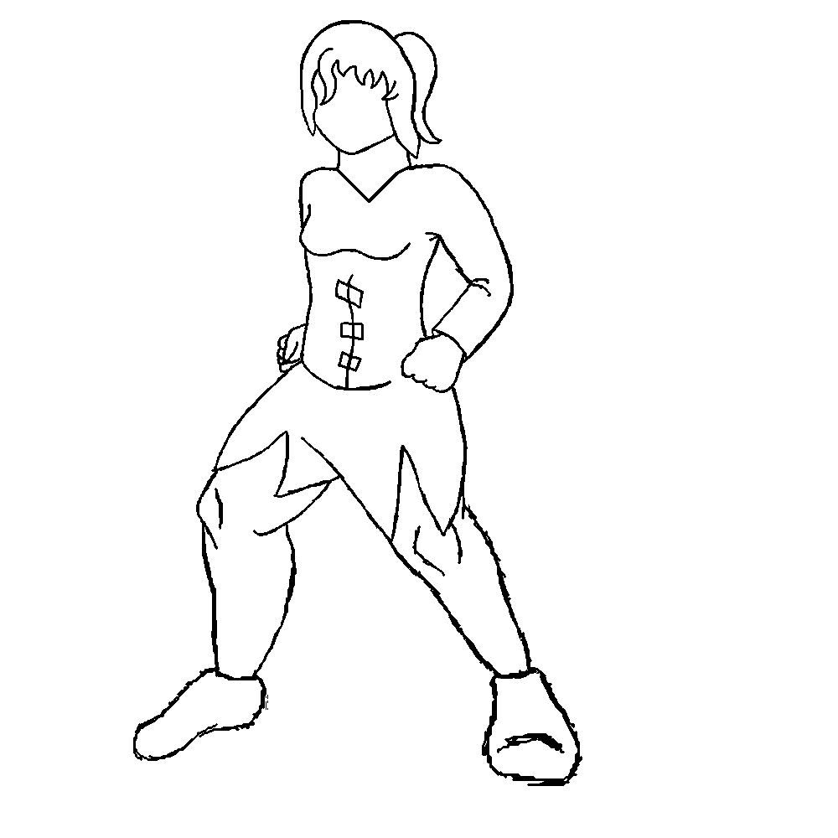
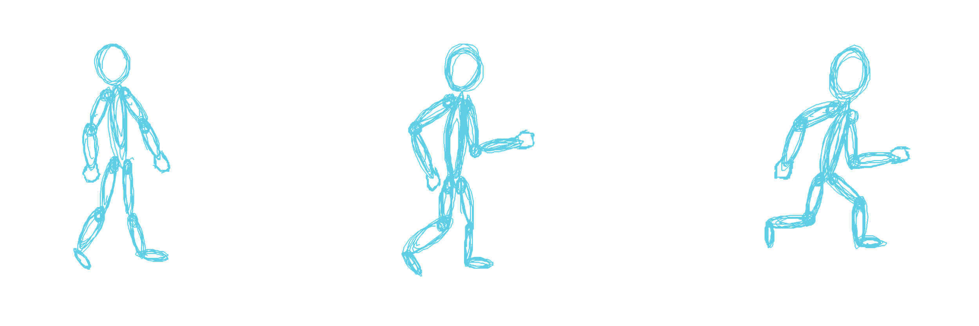
Art
Prototype sprites for Lynne and Randolf
More detailed idle animations
Next step: Figure Animations

Slide 10
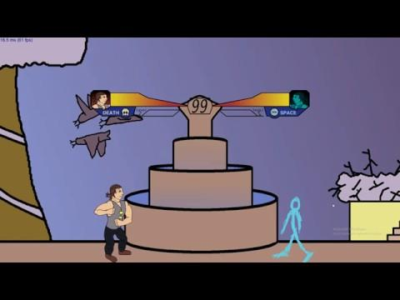
Game Demo

Slide 11
